Slide 1
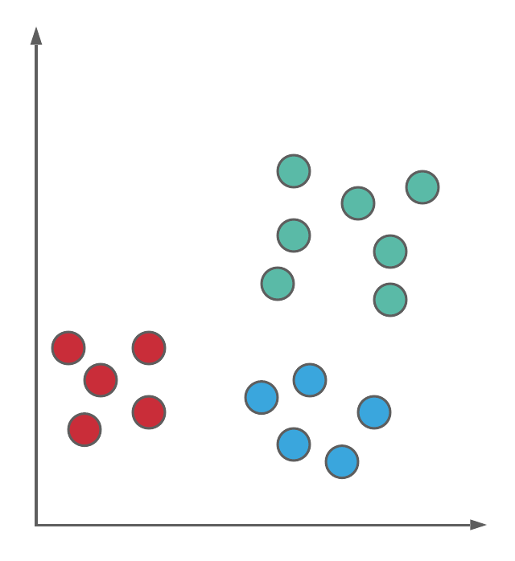
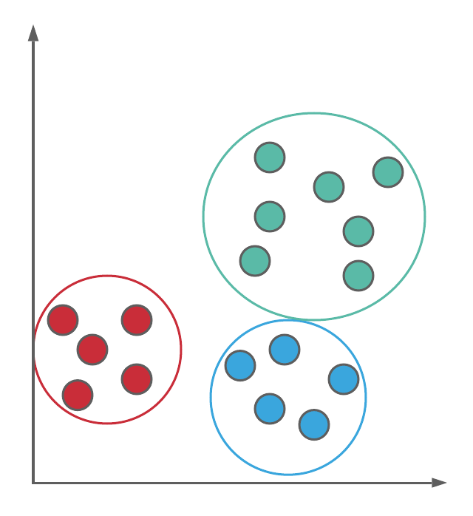
Clustering Algorithms
Unsupervised Learning Technique

Slide 2
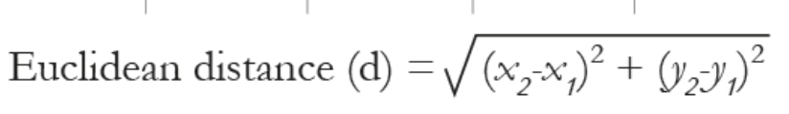
KMeans Clustering

Slide 3
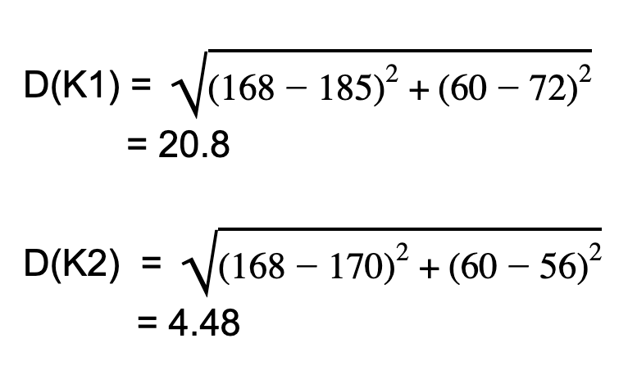
Item Price | Quantity Solds
185 | 72
170 | 56
168 | 60
179 | 68
182 | 72
K1(185,72)
K2(170,56)
Euclidean Distance for 3rd item

Slide 4
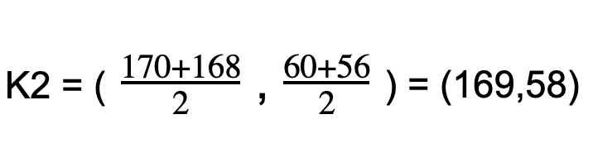
New Centroid Calculation
K1(185,72)
Item 2 and
Item 3
K2(169,58)
Item 1

Slide 5
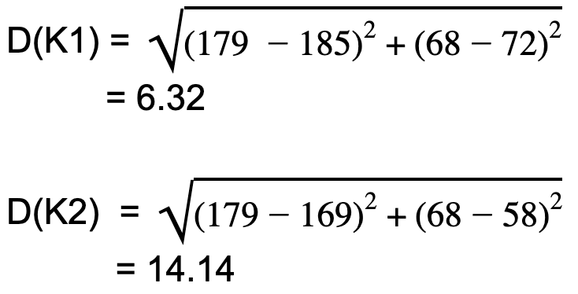
Item Price | Quantity Solds
185 | 72
170 | 56
168 | 60
179 | 68
182 | 72
K1(185,72)
K2(169,58)
Distance Calculation for K4

Slide 6
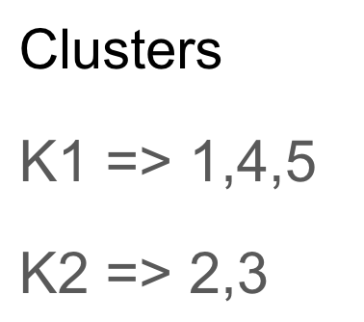

Slide 7
Applications
Segmentation of users based on purchase history
Group images to various categories
Group Inventory

